Slide 1
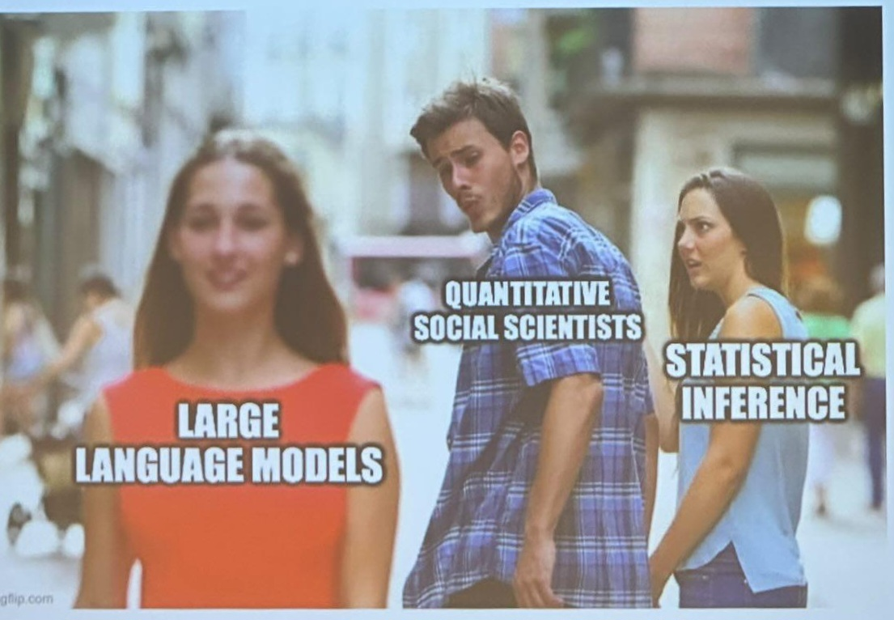
Introduction to Python & Text-as-Data
Department of Government: Methods Brown Bag (Fall 2025)
Samirah Jaigirdar

Slide 2
Why Python for Text Data Analysis?
What is Colab?
Python is a general-purpose, object-oriented programming language that emphasizes code readability
Well suited for deploying machine learning at a large scale
Many Python libraries can be used for data science purposes:
Numpy – Large Dimensional Arrays
Pandas – Data Manipulation & Analysis (us!!)
Matplotlib – Data Visualizations (kind of ugly; use ggplot)
Browser Notebook + free GPU/CPU
Allows you to run Python code in a Jupyter notebook environment without any setup on your device
You can combine executable code with text, images, and LaTeX in a single document (but don’t ask me how)
Can share the Colab Doc with anyone and thus, can edit and code together!
Best Part: Has Google AI built in to it (if you opt in) and it will fix your code for you ☺

Slide 3
Syntax Differences between Python & R
Blocks By Indentation
x = 7
if x > 5: # colon starts a block
print("big") # 4 spaces indent
else:
print("small")
0-based indexing + slicing (stop is exclusive)
nums = [10, 20, 30, 40, 50]
first = nums[0] # 10
last = nums[-1] # 50
sub = nums[1:4] # [20, 30, 40] (stops before index 4)
every2 = nums[::2] # [10, 30, 50]
reversed_nums = nums[::-1] # [50, 40, 30, 20, 10]
Assignment (=) vs Equality (==)
a = 3 # assign
b = 3
a == b # True (equality check)

Slide 4
Filter:
R: df %>% filter(year > 2010, country == "India")
Python:
df.query("year > 2010 and country == 'India'")
Select Columns:
R: df %>% select(country, year, gdp)
Python:
df[["country", "year", "gdp"]]
Mutate:
R: df %>% mutate(gdp_pc = gdp / pop,
decade = floor(year / 10) * 10)
Python: (pandas)
df.assign(gdp_pc = df["gdp"] / df["pop"],
decade = (df["year"] // 10) * 10)
Left Join:
R: left_join(df_left, df_right, by = "id")
Python:
df_left.merge(df_right, on="id", how="left")

Slide 5
Concept | R / tidyverse | Python / pandas
What do we use it in? | RMarkdown / Quarto / RStudio | Colab / Jupyter
Assign | x <- 5 | x = 5
Index base | 1 | 0
Equality / logic | ==, &, ` | , !`
Missing | NA | None, NaN
List/dict | list(), list(a=1) | [ ... ], { "a": 1 }
Data frame | data.frame()/tibble() | pd.DataFrame(...)
Select/filter | select(col), filter(x > 0) | df[["col"]], df.query("x > 0")
Mutate | mutate(z = x+y) | df.assign(z = df.x + df.y)
Group/summarize | `group_by() | > summarize()`
Pipe/chain | ` | >/%>%`

